Slide 1

DOSETWIN AI: A DIGITAL TWIN FRAMEWORK FOR PERSONALIZED DRUG RESPONSE SIMULATION AND MEDICATION CONFLICT PREVENTION
SOA Project Review-1
Thursday, August 20th, 2026
 | Under the Guidance of Dr. Srikanth Cherukuvada Assistant Professor, Department of Computer Science and Engineering, KLH CSE Bowrampet Campus
Team Members P Ruthvik 2420030546 S.Akshay 2420030579 P.Nitish 2420030642

Slide 2
Outline of Research Work
Focus
Introduction
Literature Survey
Challenges
Research Objectives
Conclusion & Future Work
References
Publications Details

Slide 3
Problem Statement
Conventional medication decision-making often relies on generalized patient information and predefined drug-interaction databases, which may not fully capture an individual's unique clinical characteristics. Variations in medical history, existing medications, laboratory results, vital signs, demographic information, and clinical conditions can influence drug response and medication-related risks. Existing approaches also have limited capability to represent the patient's dynamic clinical state and simulate potential medication responses before treatment decisions. Therefore, DoseTwin AI proposes an intelligent, patient-specific framework integrating Digital Twins, HL7 FHIR, TensorFlow, Knowledge Graphs, FastAPI, PostgreSQL, and Docker to enable personalized drug-response simulation and medication conflict prevention.

Slide 4
Objectives
To develop a Digital Twin of the patient that represents dynamic clinical information such as medical history, medications, vital signs, and laboratory parameters.
To integrate HL7 FHIR for standardized and interoperable healthcare data representation and exchange.
To implement TensorFlow-based drug-response prediction for analyzing potential personalized responses to selected medications.
To develop a Knowledge Graph using Neo4j to represent relationships between drugs, diseases, medications, and potential interactions.
To detect potential medication conflicts and generate risk levels, explanations, and supporting recommendations based on patient-specific information.
To integrate FastAPI, PostgreSQL, and Docker to provide a scalable, persistent, and containerized healthcare analysis framework.

Slide 5
Literature Survey
Authors | Title of the Paper | Methodology | Inferences | Limitation / Future Work
Saratkar et al. [1] | Digital Twin for Personalized Medicine Development, Frontiers in Digital Health, 2025 | • Digital Twin models for patient-specific healthcare• Integration of AI, ML and patient data | • Supports personalized treatment and predictive healthcare• Enables patient-specific simulation and treatment planning | • Data privacy and interoperability remain challenges• Requires further clinical validation
Ludwig et al. [2] | Digital Patient Twins for Therapeutics and Pharmaceutical Manufacturing, Frontiers in Digital Health, 2023 | • Digital Patient Twins using patient and population data• AI and data-driven modeling | • Supports personalized drug treatment• Highlights potential for predicting individual drug responses | • Reliable individual drug-response simulation remains limited• Regulatory and scalability challenges remain
Wollard et al. [3] | Digital Pharmacological Twins: Bridging Multi-Scale Modeling and Artificial Intelligence for Precision Medicine, Therapie, 2026 | • Multi-scale pharmacological modelling• AI/ML with pharmacokinetic and pharmacodynamic data | • Supports simulation of drug interactions and individual treatment responses• Can assist with dosing and adverse-drug-response prediction | • Requires strong data integration and model validation• Interoperability and clinical implementation require further research

Slide 6
Research Gap Identification
Existing Research / Approach | Research Gap Identified | Our Proposed Solution
1. Digital Twins for Personalized Healthcare – Existing research uses Digital Twins to represent patients by integrating medical, physiological, and health data. | Reliable patient-specific drug-response simulation is still challenging, with many approaches focusing on limited diseases or physiological conditions. | DoseTwin AI Digital Twin – Creates a patient-specific virtual model combining medical history, medications, conditions, observations, and AI-based drug-response prediction.
2. AI-Based Drug Response & Interaction Prediction – Machine Learning and pharmacological models are used to predict drug effects, adverse reactions, and drug–drug interactions. | Existing approaches often focus on individual prediction tasks rather than continuously combining patient characteristics, medication information, and drug relationships. | AI Drug Response & Conflict Engine – Uses TensorFlow + Knowledge Graphs to analyze patient-specific factors, medicines, and relationships for drug-response and conflict analysis.
3. FHIR-Based & Knowledge-Graph Healthcare Systems – Existing systems use HL7 FHIR, Knowledge Graphs, and AI to improve healthcare interoperability and patient-centric analysis. | There is a need for an integrated and scalable architecture connecting standardized healthcare data, patient state, AI prediction, and medication safety analysis. | FHIR-Enabled Integrated Architecture – Combines HL7 FHIR + Digital Twin + TensorFlow + Knowledge Graph + FastAPI + PostgreSQL + Docker for personalized drug analysis and medication conflict prevention.

Slide 7
Novelty
The novelty of DoseTwin AI lies in integrating multiple intelligent healthcare technologies into a single patient-specific framework:
Digital Twin–based patient modeling for representing the patient’s changing clinical state.
TensorFlow-based personalized drug-response simulation instead of relying only on general drug information.
Neo4j Knowledge Graph to connect patients, drugs, conditions, observations, and medication interactions.
HL7 FHIR integration for standardized and interoperable healthcare data.
Combined risk analysis using patient information, predicted drug response, and medication-conflict relationships.
End-to-end containerized architecture using FastAPI, PostgreSQL, and Docker for scalable deployment.

Slide 8
Tech Stack
Layer | Technology Stack
Core Framework | Digital Twin
Healthcare Data & Interoperability | HL7 FHIR
AI & Machine Learning | TensorFlow
Knowledge Representation | Knowledge Graphs
Backend / Microservices | FastAPI
Database | PostgreSQL
DevOps / Deployment | Docker

Slide 9
Innovation, Creativity, and Novelty
Innovation
AI-Driven Personalized Drug Analysis
Uses TensorFlow with patient-specific clinical data to support personalized drug-response simulation.
Creativity
Digital Twin + Knowledge Graph Integration
Combines a patient Digital Twin with a Knowledge Graph to connect patient conditions, medications, observations, and drug interactions.
Novelty
Integrated Patient-Specific Risk Assessment
Combines Digital Twin data, AI prediction, medication conflict detection, and HL7 FHIR within a single healthcare framework.

Slide 10
Feasibility
Technical Feasibility
Uses established technologies such as FastAPI, TensorFlow, Neo4j, PostgreSQL, HL7 FHIR, and Docker, which can be integrated into the proposed system.
Operational Feasibility
Provides a simple web-based interface for entering patient information, analyzing medications, and viewing drug-response and conflict results.
Economic Feasibility
Uses open-source frameworks and tools, reducing development and deployment costs.
Scalability Feasibility
The Docker-based architecture allows individual components to be deployed, maintained, and scaled as the system grows.

Slide 11
Project Plan
Phase | Activity | Output
Phase 1 | Requirement Analysis & Literature Survey | Finalized requirements and research gap
Phase 2 | Digital Twin & System Architecture | Patient Digital Twin and integrated architecture
Phase 3 | HL7 FHIR Data Integration | Standardized patient, medication & observation data
Phase 4 | TensorFlow AI Model Development | Personalized drug-response prediction
Phase 5 | Neo4j Knowledge Graph & Conflict Detection | Drug relationships and medication conflict analysis
Phase 6 | FastAPI, PostgreSQL & Docker Integration | Integrated backend, persistent database and containerized system
Phase 7 | Testing, Validation & Final Demonstration | Validated working prototype and final project documentation

Slide 12
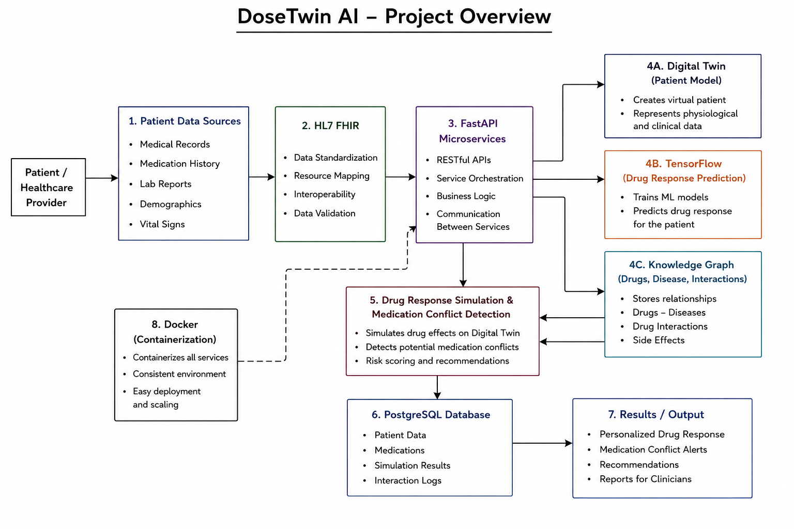
Project Architecture/Project Overview:

